Slide 1
Developing a Teaching Agenda
The Thirteenth Meeting of New Researchers in Statistics and Probability
Vancouver, British Columbia
July 30, 2010
John Gabrosek
Associate Professor
Department of Statistics
Grand Valley State University

Slide 2
Collaboration Literacy Intentionality Planning

Slide 3
Collaboration – Understanding the Teaching Culture
What are unit/university teaching expectations?
How is quality teaching measured?
Is support available for teaching research and travel?
Is publication in teaching journals valued?

Slide 4
Collaboration – Connecting to Colleagues
Use colleagues teaching materials
Find out if you can modify
Give proper credit

Slide 5
Collaboration – Connecting to Colleagues
Create a Reading Circle
Choose a teaching-related paper (philosophical and implementation papers)
Have a discussion leader
Avoid turning discussions into complaint sessions
Discuss over lunch

Slide 6
Collaboration – Connecting to Colleagues
Visit Colleagues’ Classrooms
Be aware of unit/university personnel policies
Take notes
Debrief after visit
Visit colleagues outside department

Slide 7
Literacy – Be Aware of Educational Research
Keep an eye on teaching journals
Read when you can and what you want
Look to journals for specific topics
Remember ASA membership and CIS https://www.amstat.org/membersonly/index.cfm?fuseaction=CISWeb

Slide 8
Literacy – Be Aware of Educational Research
Keep an eye on teaching journals
Journal of Statistics Education (JSE) http://www.amstat.org/publications/jse
Statistics Education Research Journal (SERJ) http://www.stat.auckland.ac.nz/~iase/publications.php?show=serj

Slide 9
Literacy – Be Aware of Educational Research
Keep an eye on teaching journals
Teaching Statistics (TS) http://www.rsscse.org.uk/ts
The American Statistician (TAS) http://pubs.amstat.org/loi/tas

Slide 10
Literacy – Be Aware of Educational Research
Keep an eye on teaching journals
Mathematics Teacher (MT) http://www.nctm.org/eresources/journal_home.asp?journal_id=2
Technology Innovations in Statistics Education (TISE) http://repositories.cdlib.org/uclastat/cts/tise/

Slide 11
Literacy – Check Out Online Resources
Applets
Be judicious in use
Choose applets that actively involve students
STAT ATTIC website http://sapphire.indstate.edu/~stat-attic/index.php
CAUSE website

Slide 12
Literacy – Check Out Online Resources
Data Sets
Be sure that data can be easily read into software (or do so ahead of time)
Investigate analysis ahead of time
Collections: JSE Data Archive, CAUSEweb.org Resources, The Data and Story Library (DASL)

Slide 13
Literacy – Check Out Online Resources
Data Sets
Sources: Center for Disease Control and Prevention (CDC), Bureau of Transportation Statistics (BTS), Fish and Wildlife Research Institute, The Baseball Archive, Statistics Canada

Slide 14
Literacy – Check Out Online Resources
Assessment
Assessment Resource Tools for Improving Statistical Thinking (ARTIST)
The Survey of Attitudes Toward Statistics (SATS)
Statistics Anxiety Rating Scale (STARS)

Slide 15
Literacy – Connect to the Statistics Education Community
Attend Teaching Conferences
International Conference on Teaching Statistics (ICOTS)
United States Conference on Teaching Statistics (USCOTS)
NCTM and state associations
Join ASA Section On Statistics Education

Slide 16
Intentionality – Reflect
Understand your students
Take notes on what went well and what didn’t immediately after class
Keep a teaching journal – jot down ideas and notes
Think about the student

Slide 17
Intentionality – Be Creative
Have a sense of adventure in the classroom
Make incremental changes
Assess changes
Do not get overly invested in a particular approach or idea

Slide 18
Intentionality – Don’t Get Discouraged
Expect and celebrate failures
Ask for student feedback early and often
Don’t fixate on negative comments
Make changes based on feedback
Tell students you made changes

Slide 19
Planning – Carve Out Teaching Time
Set aside time for class prep and reflection
Say No to as much as possible
Don’t feel the need to please all
Teach several quality courses rather than a dozen lousy courses

Slide 20
Planning – Carve Out Teaching Time
Work on teaching materials in the summer
Have a teaching area in your office

Slide 21
Planning – Teach Outside the Classroom
Treat research sessions with students as teaching
Incorporate research ideas in the classroom (questioning, active learning, accountability)

Slide 22
A Few Teaching Tips
Teach to your personality
don’t adopt a fake teaching persona
Be organized
the less experienced and more nervous you are the more you should have written down
Think about what the student does
Most of us like lecture
Think audio, pictures, tactile, computer simulation

Slide 23
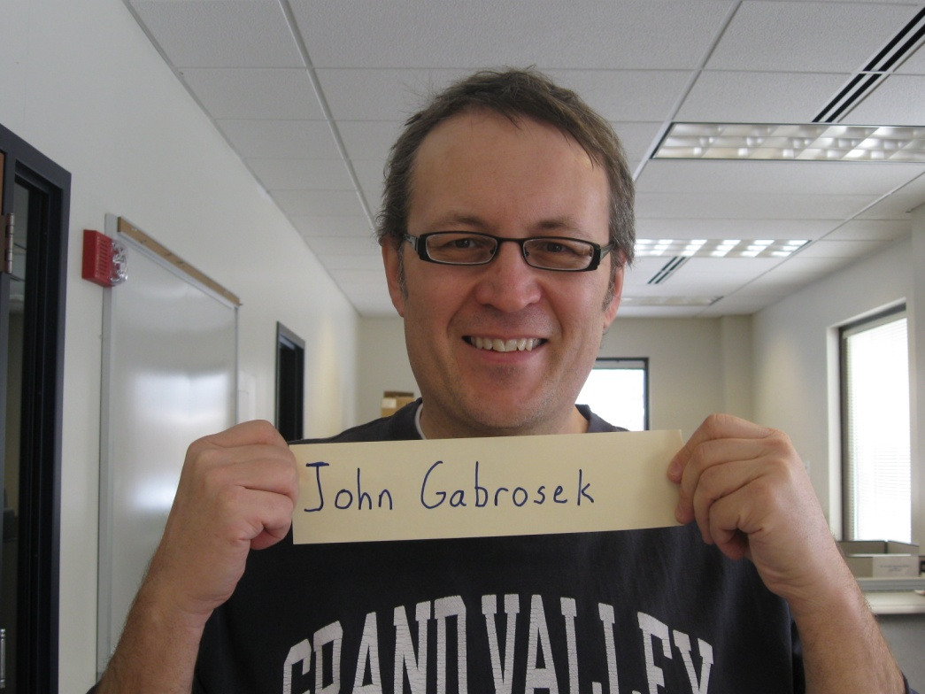
A Few Teaching Tips
Learn Names
Have students email you a picture prior to first class

Slide 24
A Few Teaching Tips
Set reasonable course rules and stick to them
Stick to your late paper policy
Make connections in course content
Make connections that seem obvious to you and do it repeatedly
Don’t forget data collection and statistical graphics as you move into inference

Slide 25
Contact Information
John Gabrosek
Associate Professor
Department of Statistics
Grand Valley State University
Webpage: http://faculty.gvsu.edu/gabrosej
Email: gabrosej@gvsu.edu

